Slide 1
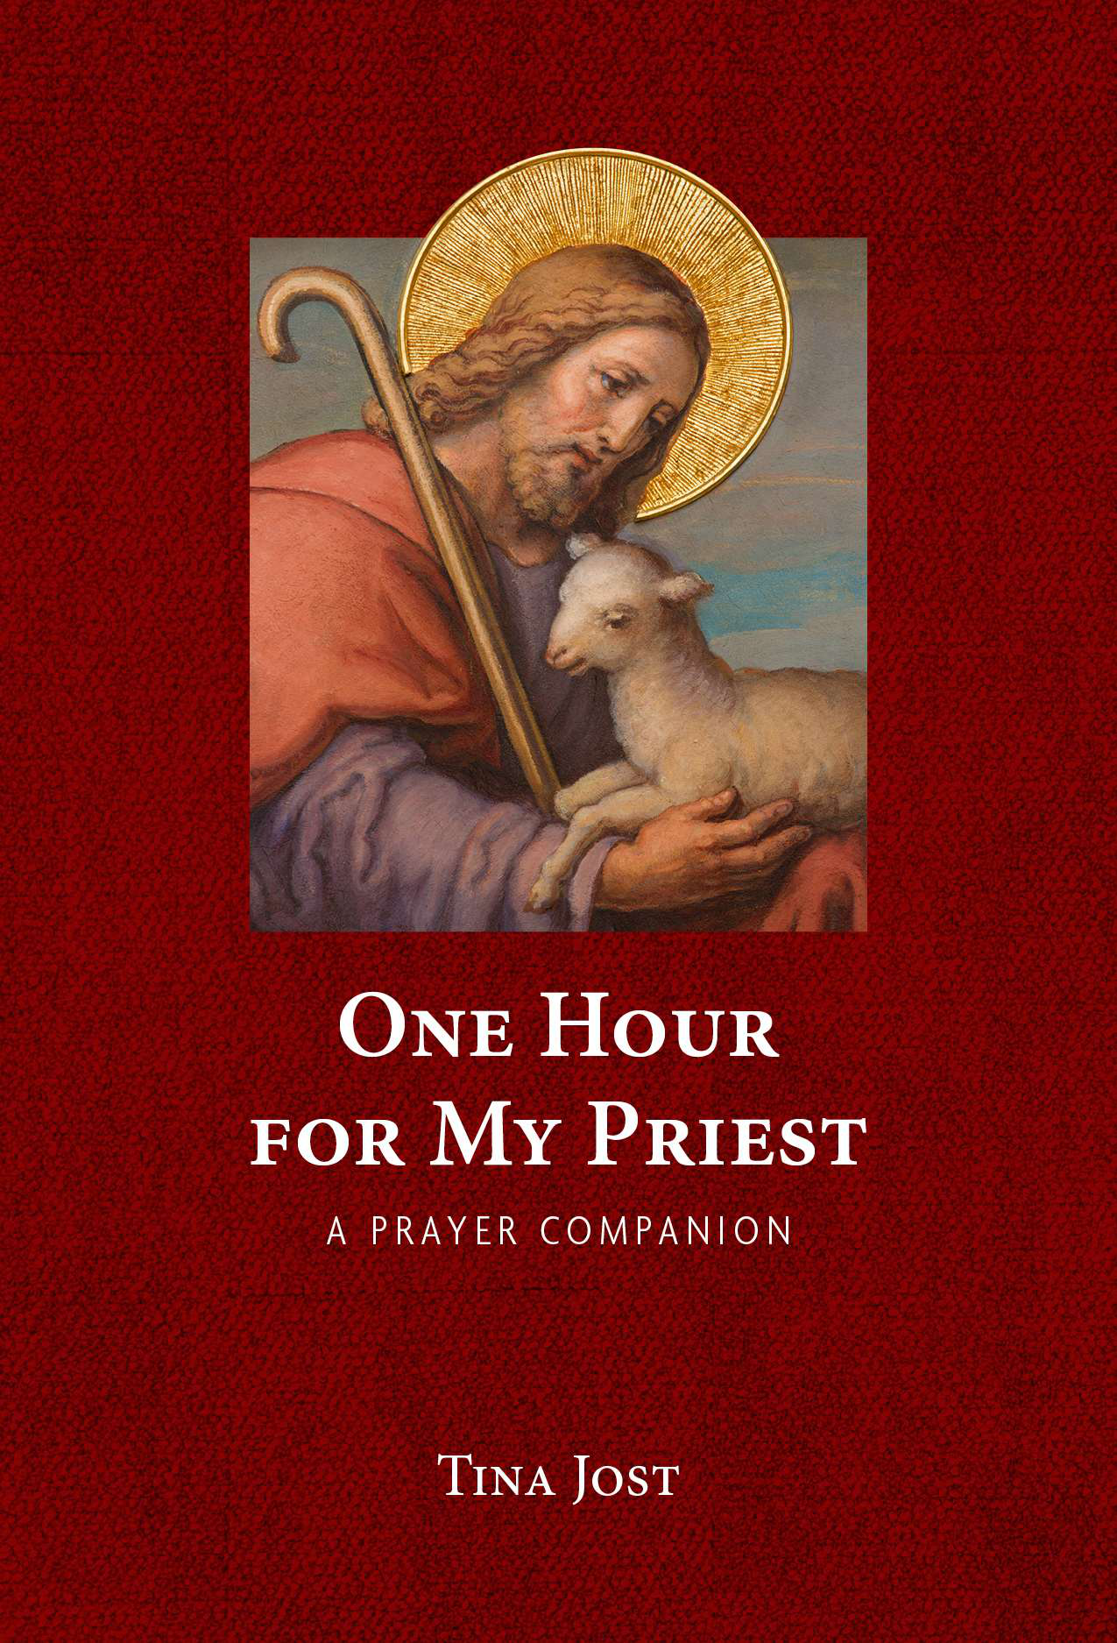
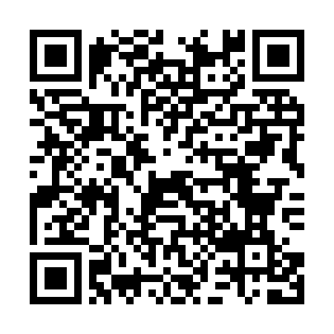
ONE HOUR FOR MY PRIEST
A Prayer Companion
A sacred invitation to bring the soul of one priest before Jesus.
HELPING CATHOLICS PRAY FOR PRIESTS
One Hour for My Priest is a devotional that helps the lay faithful pray an intentional Holy Hour for one particular priest. Whether used during Eucharistic Adoration or at home, it guides readers in praying for his protection, sanctification, healing, perseverance, and joy.
“The priesthood is the love of the heart of Jesus.”
- St. John Vianney
WHAT THIS BOOK OFFERS
RETAIL HIGHLIGHTS
A guided Holy Hour focused on one particular priest
2025
AWARD
Second Place - Prayer & Devotional
2025 Catholic Media Association Book Awards
Scripture-based prayers and meditations for Adoration or prayer at home
A meaningful way to spiritually adopt a priest and offer the gift of intercession
Published in Spain by Editorial Nueva Eva
North American Spanish edition forthcoming
A CONCRETE WAY TO PRAY FOR PRIESTS
In a time when priests face exhaustion, isolation, and spiritual attack, the faithful can respond by bringing each priest, soul by soul, before Jesus in the Eucharist.
BOOK INFORMATION
Author
Tina Jost
ISBN
978-1-63966-214-2
Publisher
Our Sunday Visitor
OSV item
T2903
List price
$12.95
View book details
Available through OSV and standard wholesale channels
One soul. One priest. One hour before the Heart of Jesus.
For review copies or additional information: Tina Jost | tinamjost@gmail.com

